Slide 1

School of Computer Science & Engg.
Offered in All Engineering U.G. Programs
Semester- 3rd Subject Code- 25CSH-211
Subject Name- Database Management System
Unit -1 Relational Model and Formal Query Languages
Chapter 1.1.1 – Database System Architecture and Three Schema Architecture.
Master Subject Coordinator
Mr. Vinod Vishwakarma
(Assistant Professor)
School of Computer Science and Engineering
www.culko.in
Nawabganj, Unnao

Slide 2
Table of Contents
Introduction to Database Systems
Three-Schema Architecture
Data Independence
Advantages of Three- Schema Architecture
Architecture Diagram
Conclusion
Practice Questions
www.culko.in
Nawabganj, Unnao
www.culko.in Nawabganj, Unnao

Slide 3
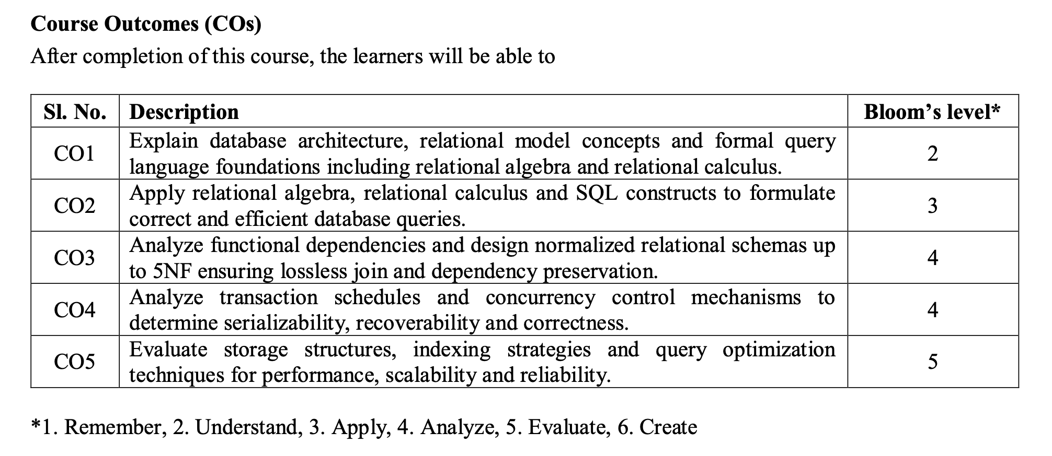
Course Outcome
www.culko.in
Nawabganj, Unnao
www.culko.in Nawabganj, Unnao

Slide 4
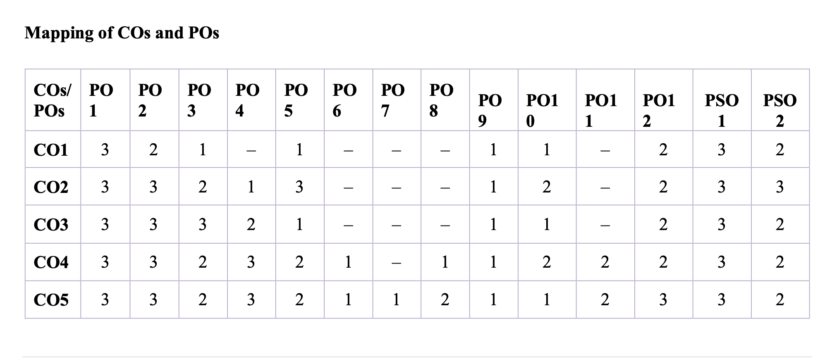
Mapping Of COs and POs
www.culko.in
Nawabganj, Unnao
www.culko.in Nawabganj, Unnao

Slide 5
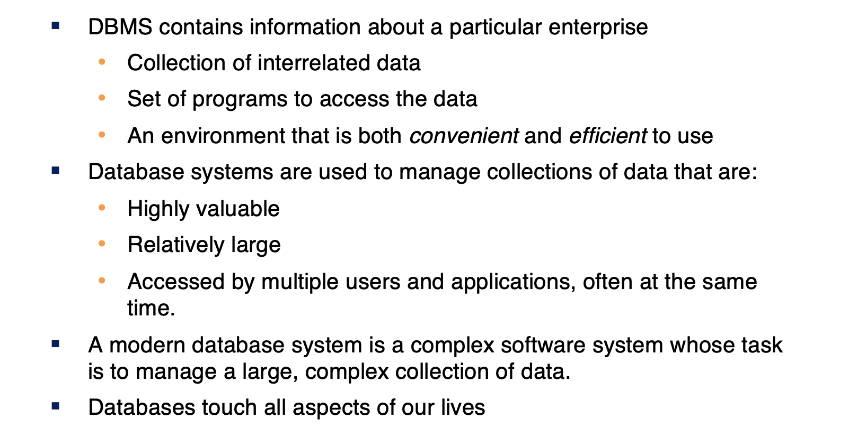
1. Introduction To Database Systems
www.culko.in Nawabganj, Unnao

Slide 6
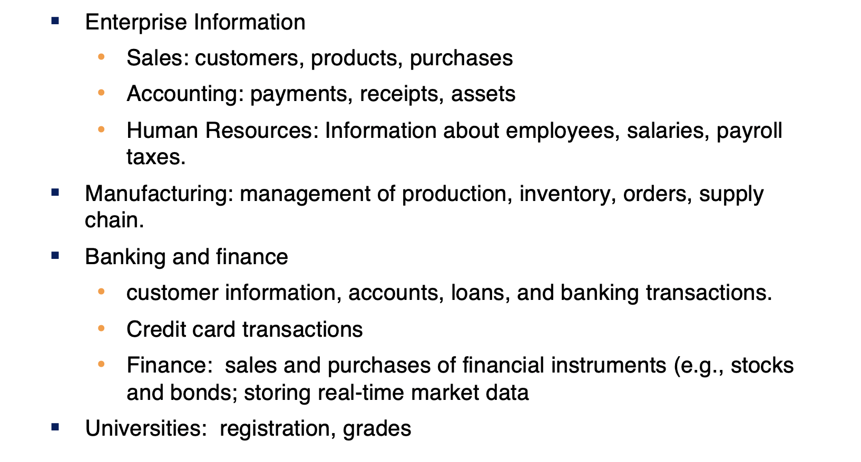
Database Applications Examples
www.culko.in
Nawabganj, Unnao
www.culko.in Nawabganj, Unnao

Slide 7
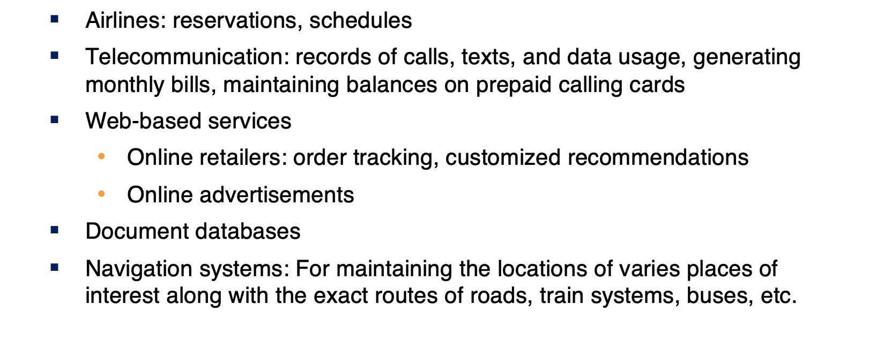
Database Applications Examples(Cont.)
www.culko.in
Nawabganj, Unnao
7
www.culko.in Nawabganj, Unnao

Slide 8
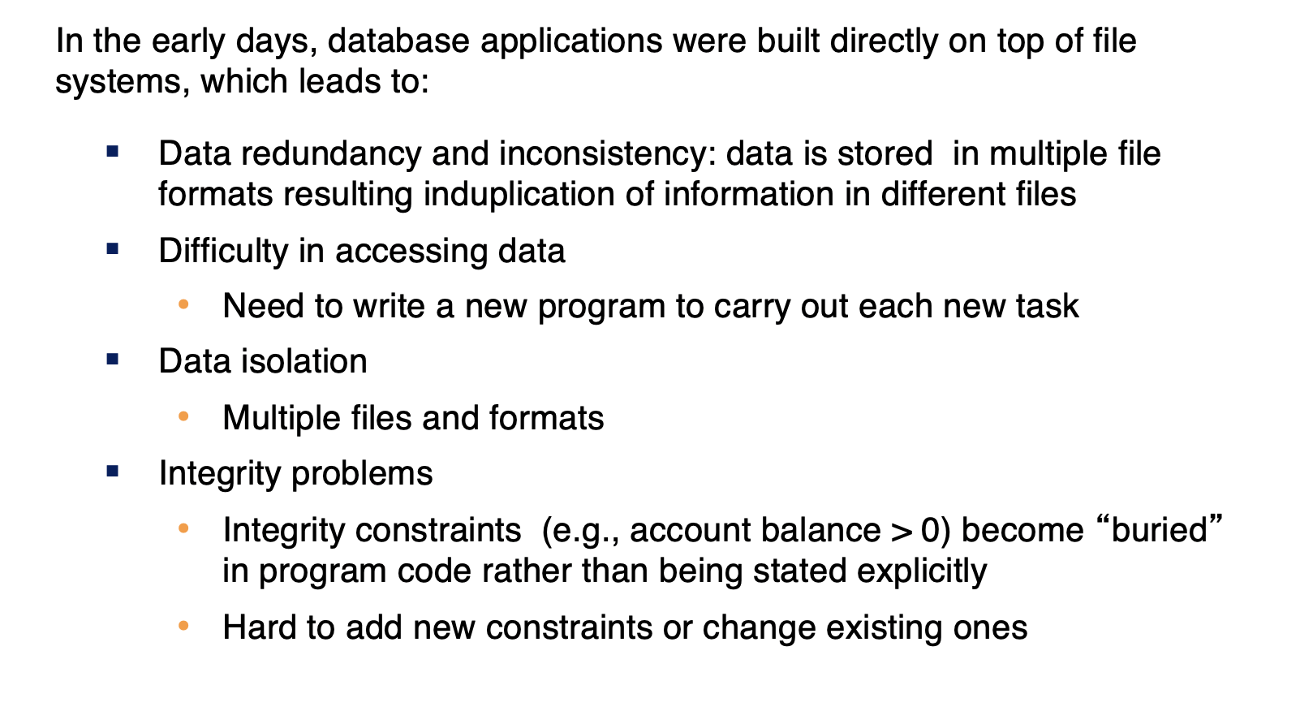
Purpose of Database Systems
www.culko.in
Nawabganj, Unnao
8
8
www.culko.in Nawabganj, Unnao

Slide 9
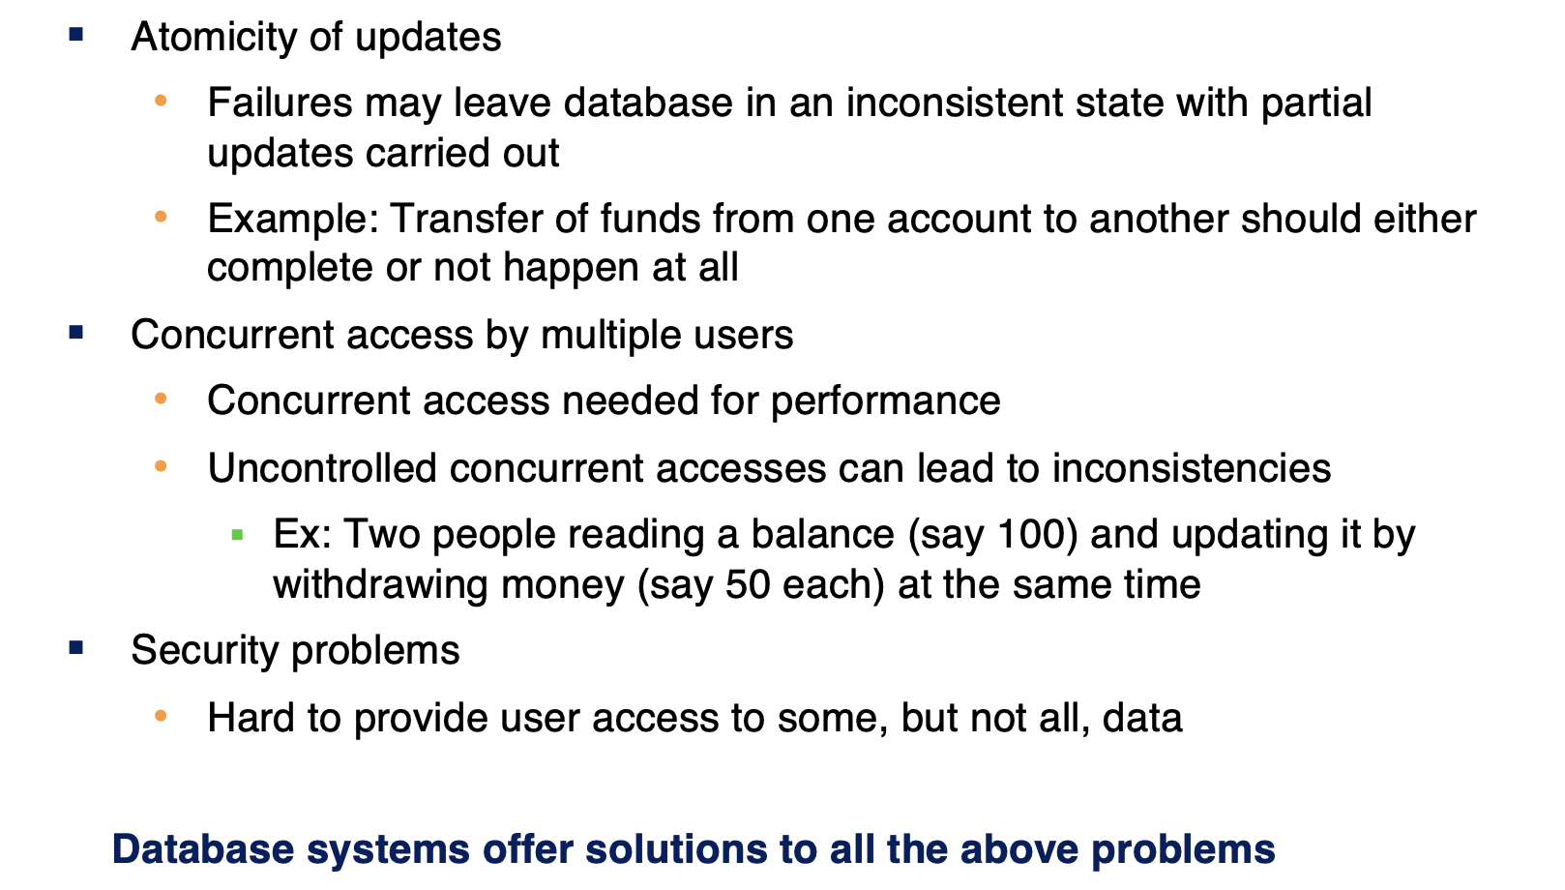
Purpose of Database Systems(Cont.)
www.culko.in
Nawabganj, Unnao
9
9
9
www.culko.in Nawabganj, Unnao

Slide 10
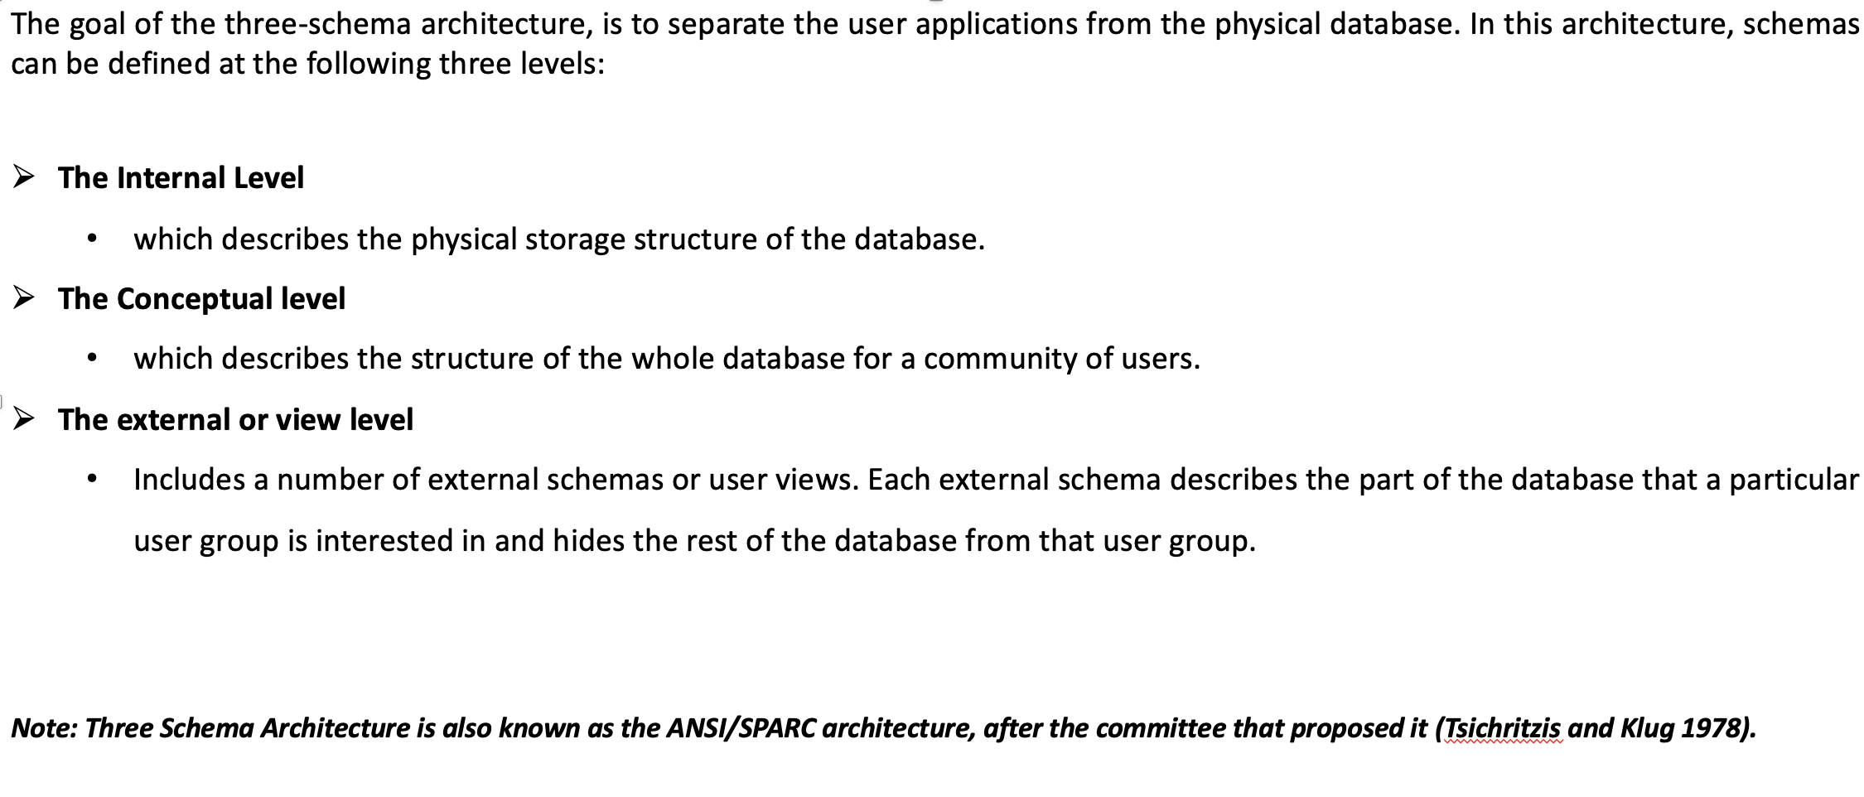
2. Three-Schema Architecture
www.culko.in Nawabganj, Unnao

Slide 11
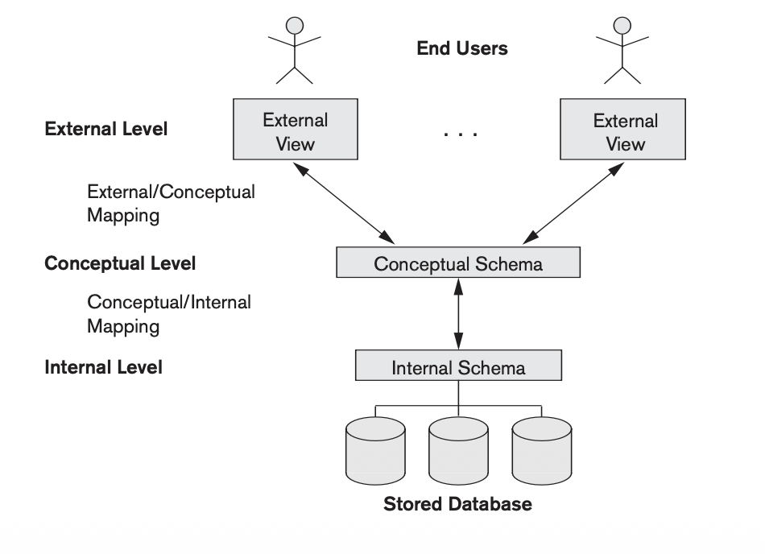
Fig.1.1. Three- Schema Architecture
www.culko.in Nawabganj, Unnao

Slide 12
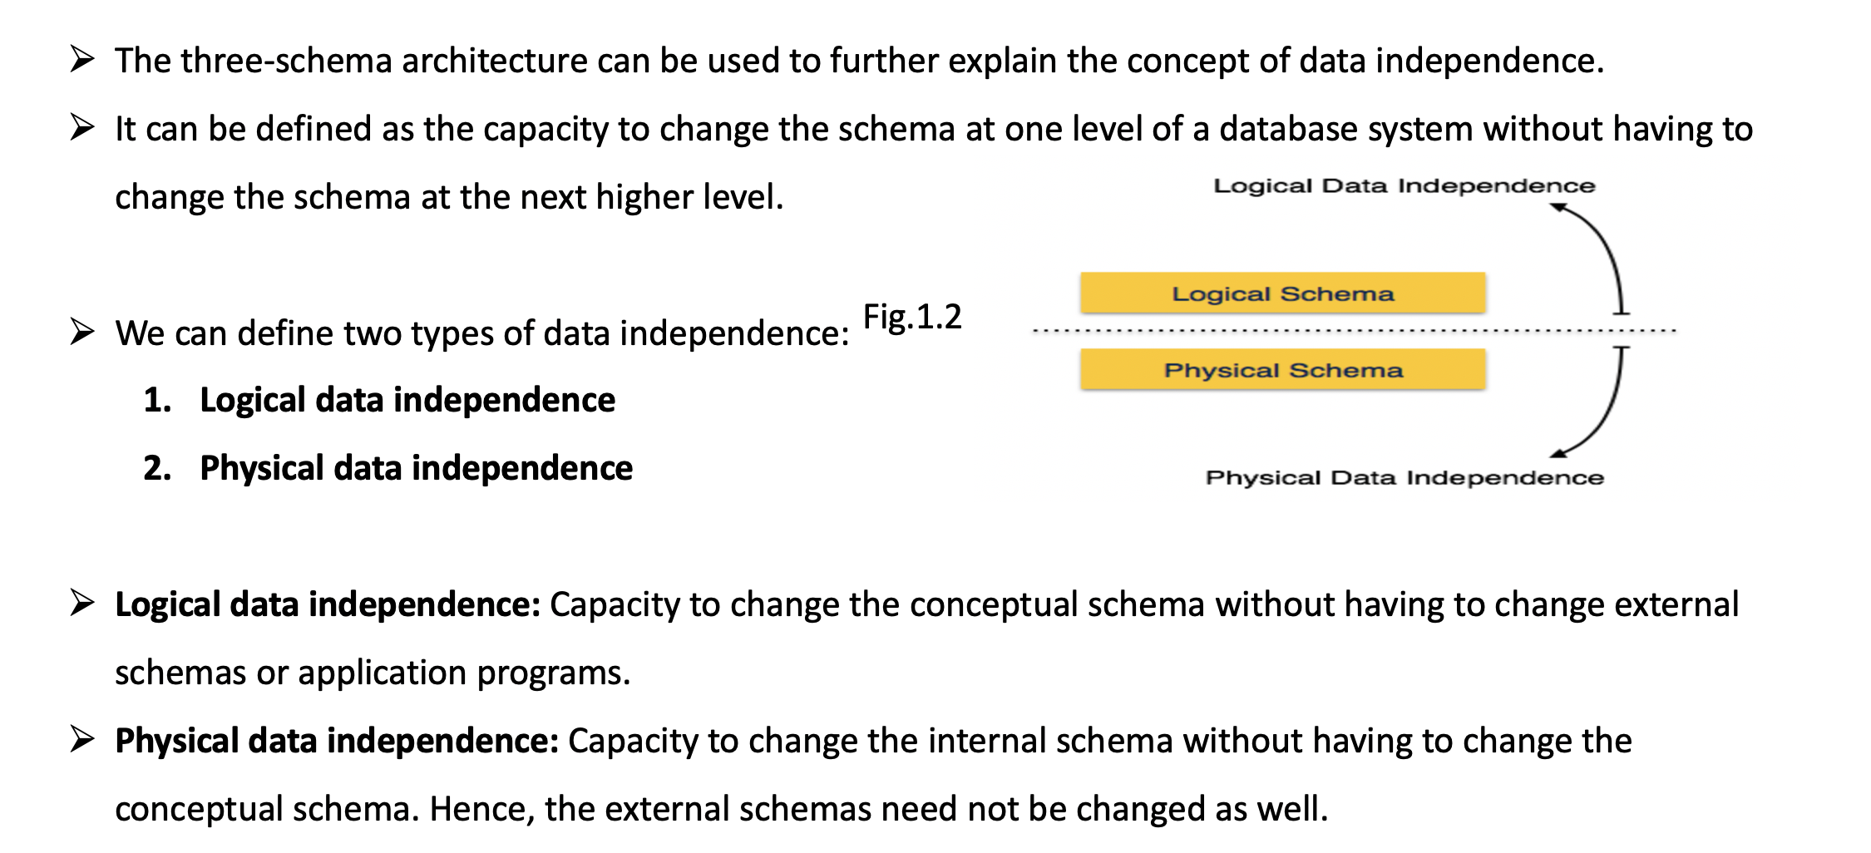
3. Data Independence
www.culko.in
Nawabganj, Unnao
www.culko.in Nawabganj, Unnao

Slide 13
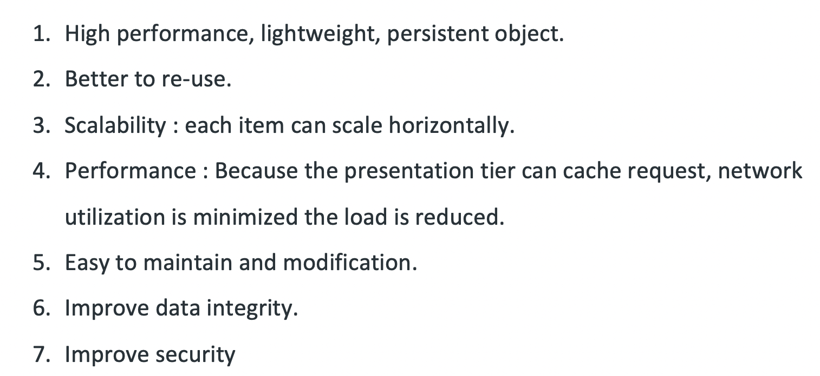
4. Advantages of Three-Schema Architecture
www.culko.in
Nawabganj, Unnao
www.culko.in Nawabganj, Unnao

Slide 14
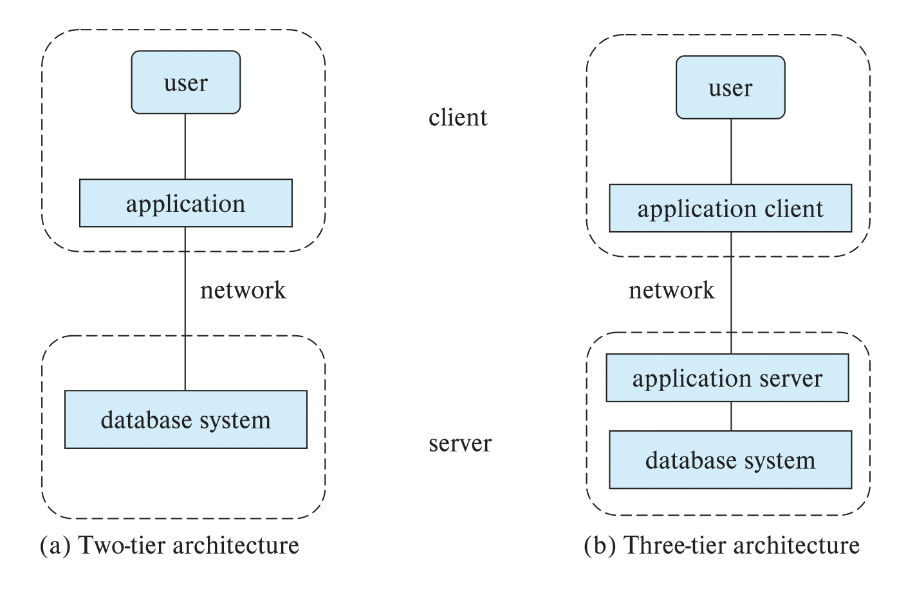
5. Architecture Diagram
www.culko.in
Nawabganj, Unnao
www.culko.in Nawabganj, Unnao

Slide 15
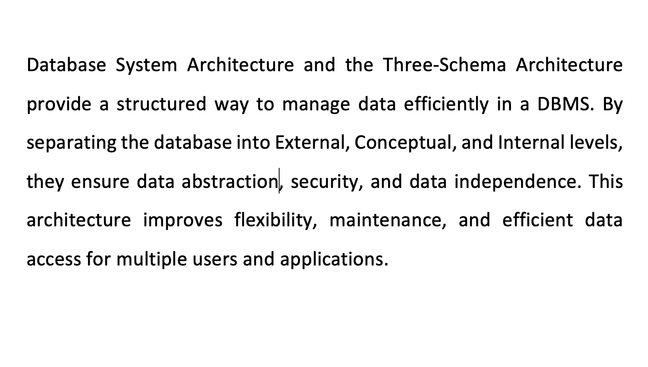
6. Conclusion
www.culko.in
Nawabganj, Unnao
www.culko.in Nawabganj, Unnao

Slide 16
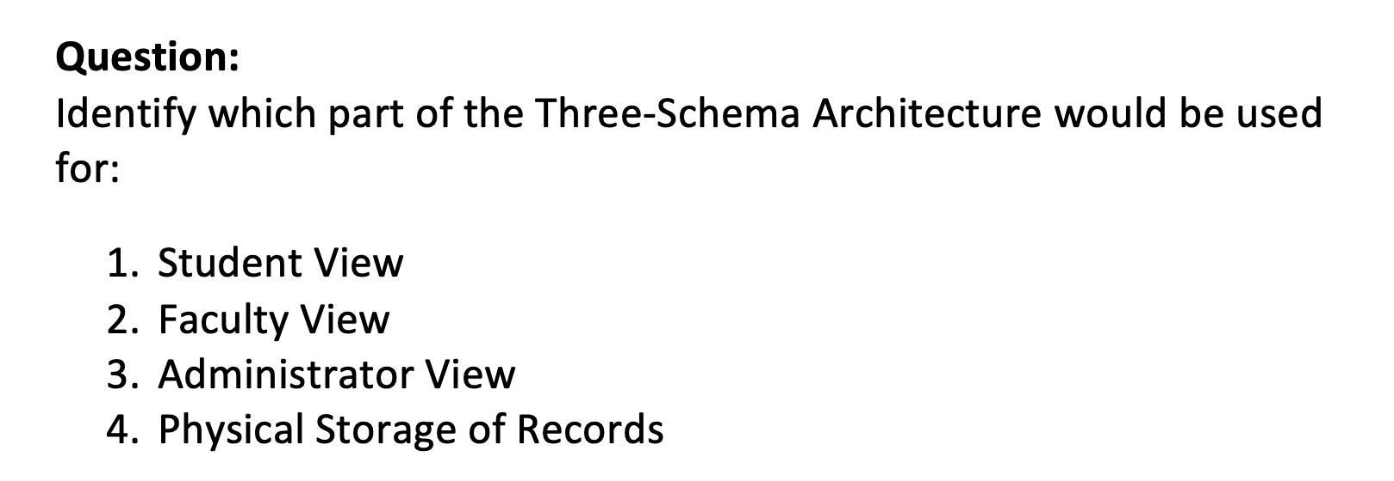
7. Practice Question
www.culko.in
Nawabganj, Unnao
www.culko.in Nawabganj, Unnao

Slide 17
References
Elmasri, R., & Navathe, S. B. (2017). Fundamentals of database systems (7th ed.). Pearson.
Silberschatz, A., Korth, H. F., & Sudarshan, S. (2019). Database system concepts (7th ed.). McGraw-Hill..
www.culko.in
Nawabganj, Unnao
www.culko.in Nawabganj, Unnao

